Slide 1
Work Package 3
BioMA multi-model monitoring
Valentina Pagani¹, Roberto Confalonieri¹, Simone Bregaglio¹, Caterina Francone¹, Giovanni Cappelli¹, Wang Zhiming², Li Bingbai², Qiu Lin², Manola Bettio³, Stefan Niemeyer³, Marcello Donatelli³, Riad Balaghi⁴
¹ University of Milan, Department of Plant Production, CASSANDRA modelling team
² Jiangsu Academy of Agricultural Sciences
³ European Commission Joint Research Centre, IES, AGRI4CAST
⁴ INRA Morocco
roberto.confalonieri@unimi.it
E-AGRI WP3 – Second progress meeting - Nanjing, December 10-12, 2012

Slide 2
Scientific issues related to WP3
Multi-model approach to crop yield estimates
WOFOST (gross photosynthesis, CO₂ assimilation)
CropSyst (mostly based on water potentially transpired)
WARM (only for rice; advanced radiation use efficiency approach)
Simulation of the impact of diseases and abiotic damages on crop productivity
Diseases
Rice: blast (Pyricularia oryzae) and brown spot (Helminthosporium oryzae)
Wheat: leaf rust (Puccinia recondita)
Abiotic damages
Sterility due to thermal shocks
E-AGRI WP3 – Second progress meeting - Nanjing, December 10-12, 2012

Slide 3
WP3 tasks description
Task 3.1: Ground data collection for BioMA
Task 3.2: Adaptation of BioMA for multi-model rice monitoring in Jiangsu
Task 3.3: BioMA piloting for multi-model rice monitoring and yield forecasting in Jiangsu
Task 3.4: Adaptation of BioMA for multi-model wheat monitoring in Morocco
Task 3.5: BioMA piloting for multi-model wheat monitoring and yield forecasting in Morocco
E-AGRI WP3 – Second progress meeting - Nanjing, December 10-12, 2012
Rice, Jiangsu
Wheat, Morocco
Task 3.1
BioMA adaptation
Task 3.2
Task 3.4
BioMA piloting
Task 3.3
Task 3.5

Slide 4
WP3 tasks description
E-AGRI WP3 – Second progress meeting - Nanjing, December 10-12, 2012
Rice, China
Wheat, Morocco
Task 3.1
BioMA adaptation
Task 3.2
Task 3.4
BioMA piloting
Task 3.3
Task 3.5

Slide 5
Task 3.1 description
Partners: JAAS, INRA, UMIL
E-AGRI WP3 – Second progress meeting - Nanjing, December 10-12, 2012
D31.1
D31.1
MS1
MS1
MS1
Rice, China
Wheat, Morocco
Task 3.1
BioMA adaptation
Task 3.2
Task 3.4
BioMA piloting
Task 3.3
Task 3.5

Slide 6
Task 3.1 deliverables
Partners: JAAS, INRA, UMIL
Rice in Jiangsu
We received all the data from first year experiments (shown in the previous progress meeting)
Data from the second year have been collected and they are going to be prepared and organized for being used for models calibration/validation
Wheat in Morocco
We did not received E-AGRI data at the moment:
We delivered a report with data collected in the past (not specifically collected for parameterizing crop models)
We received a report (MS Word) with data from field experiments carried out within E-AGRI (MS1)… but when we asked for data in a usable format, we did not receive any reply
E-AGRI WP3 – Second progress meeting - Nanjing, December 10-12, 2012

Slide 7
Task 3.2&4 description
Partners: UMIL, JRC
E-AGRI WP3 – Second progress meeting - Nanjing, December 10-12, 2012
D32.1 – D34.1[6]
MS2
Rice, China
Wheat, Morocco
Task 3.1
BioMA adaptation
Task 3.2
Task 3.4
BioMA piloting
Task 3.3
Task 3.5

Slide 8
Task 3.2 deliverables
Partners: UMIL, JAAS, JRC
Calibration of parameters for each group of cultivars and for each crop model (WARM, WOFOST and CropSyst) for rice in Jiangsu
Nine experimental sites
Different state variables were monitored with the specific aim of collecting data for model calibration/validation
Japonica (7 sites) and Indica (2 sites) type cultivars were grown
Rice was directly sown (5 sites) and transplanted (4 sites)
E-AGRI WP3 – Second progress meeting - Nanjing, December 10-12, 2012

Slide 9
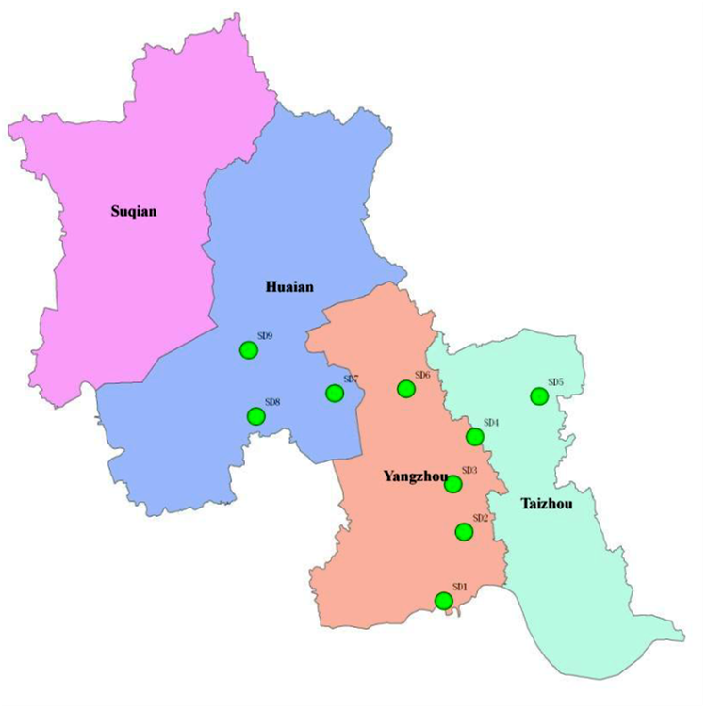
Task 3.2 deliverables
Partners: UMIL, JAAS, JRC
E-AGRI WP3 – Second progress meeting - Nanjing, December 10-12, 2012
Experiments with DIRECT SOWING | Rice variety | Rice type
SD2 | Zhendao 88 | Medium-maturing Japonica rice
SD3 | Huaidao 5 | Late-maturing Japonica rice
SD4 | Huaidao 5 | Late-maturing Japonica rice
SD5 | Huaidao 5 | Late-maturing Japonica rice
SD6 | Huaidao 5 | Late-maturing Japonica rice
EVAL
CAL
EVAL
CAL
CAL
Experiments with TRANSPLANTING | Rice variety | Rice type | Cultivation method
SD1 | Yangjing 4227 | Early-maturing Japonica rice | Mechanical transplanting
SD7 | C Liangyou 608 | Late-maturing Indica rice | Artificial transplanting
SD8 | Y Liangyou 1 | Late-maturing Indica rice | Artificial transplanting
SD9 | Huaidao 5 | Late-maturing Japonica rice | Mechanical transplanting
CAL
CAL
EVAL
EVAL

Slide 10
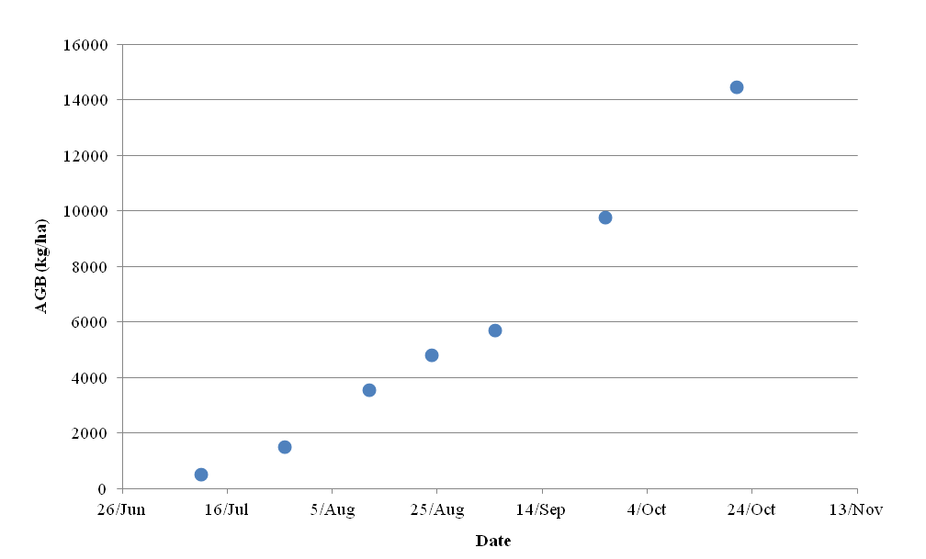
Task 3.2 deliverables
Partners: UMIL, JAAS, JRC
Analysis of growth curves
E-AGRI WP3 – Second progress meeting - Nanjing, December 10-12, 2012
Total aboveground biomass (e.g., SD3)
Linear increase
FLOWERING
MATURITY

Slide 11
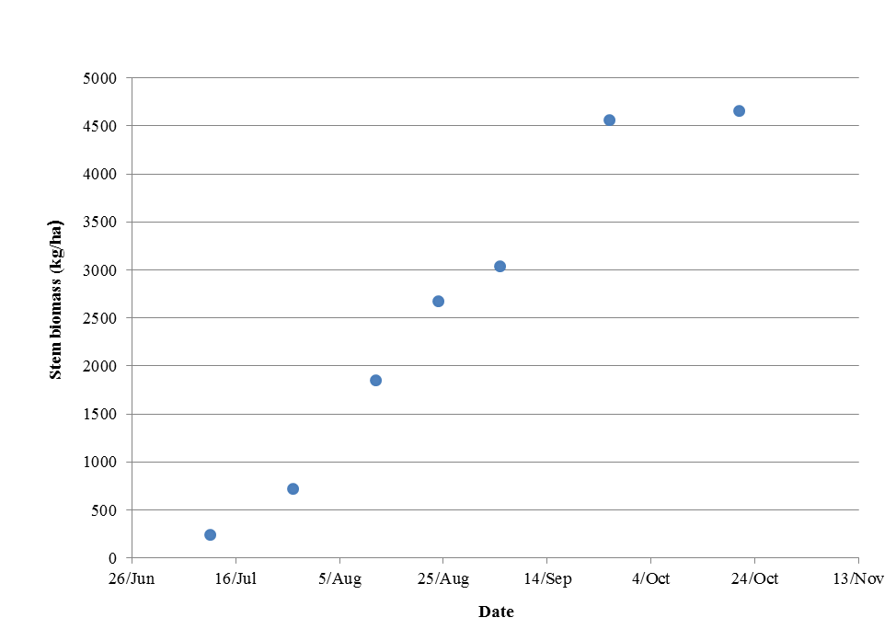
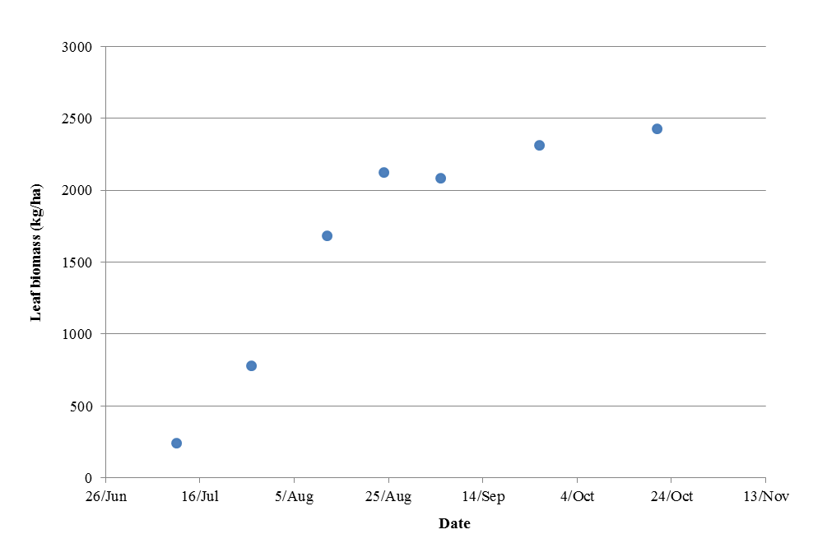
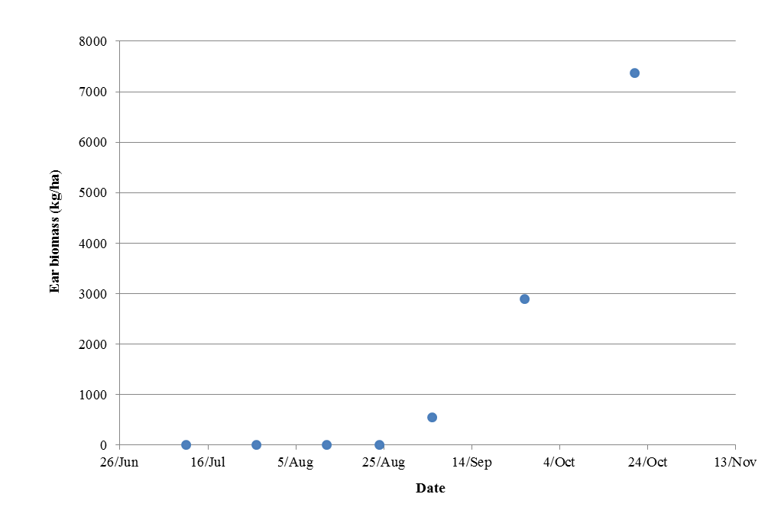
Task 3.2 deliverables
Partners: UMIL, JAAS, JRC
E-AGRI WP3 – Second progress meeting - Nanjing, December 10-12, 2012
Stem biomass
Leaf biomass
FLOWERING
Ear biomass
FLOWERING

Slide 12
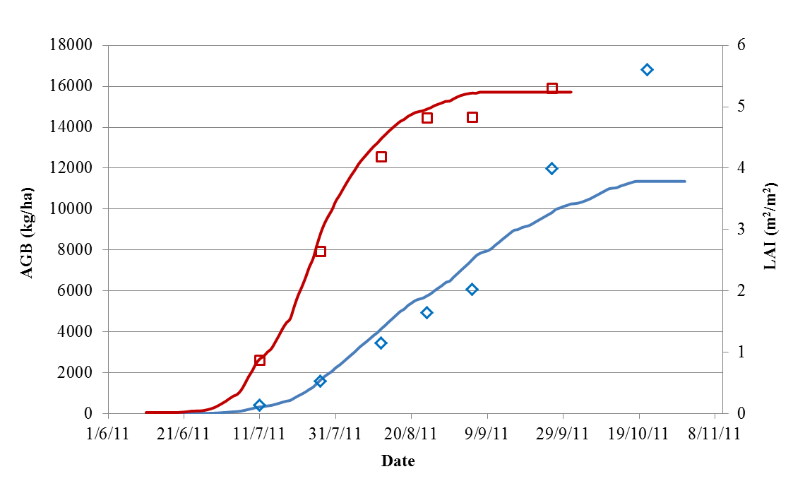
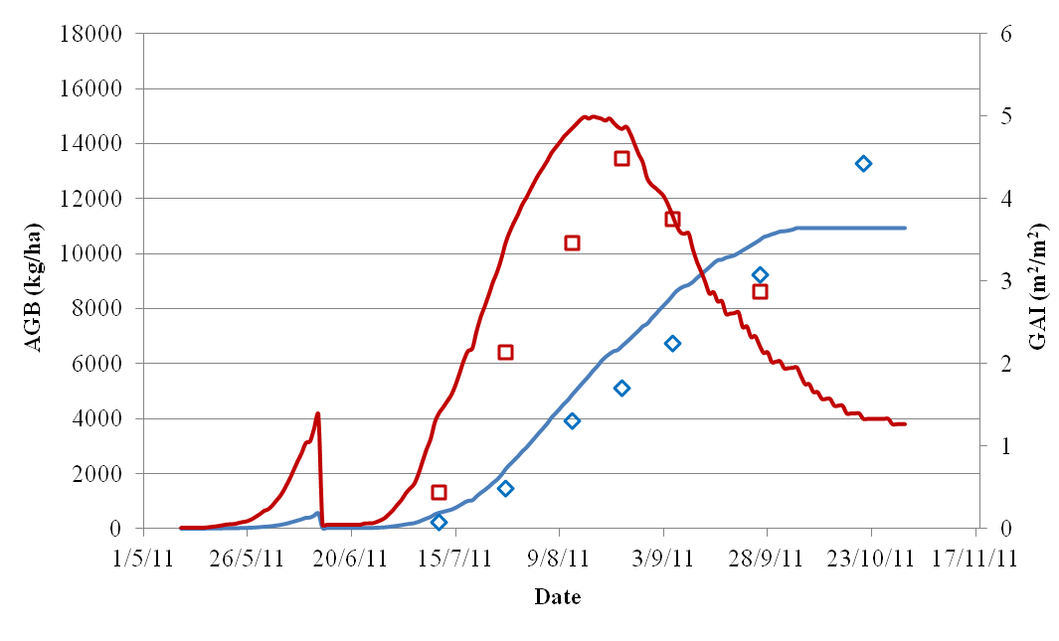
Task 3.2 deliverables
Partners: UMIL, JAAS, JRC
Calibration results (where main problems occurred) – CropSyst
E-AGRI WP3 – Second progress meeting - Nanjing, December 10-12, 2012
SD5
Direct sowing
SD1
Transplanting

Slide 13
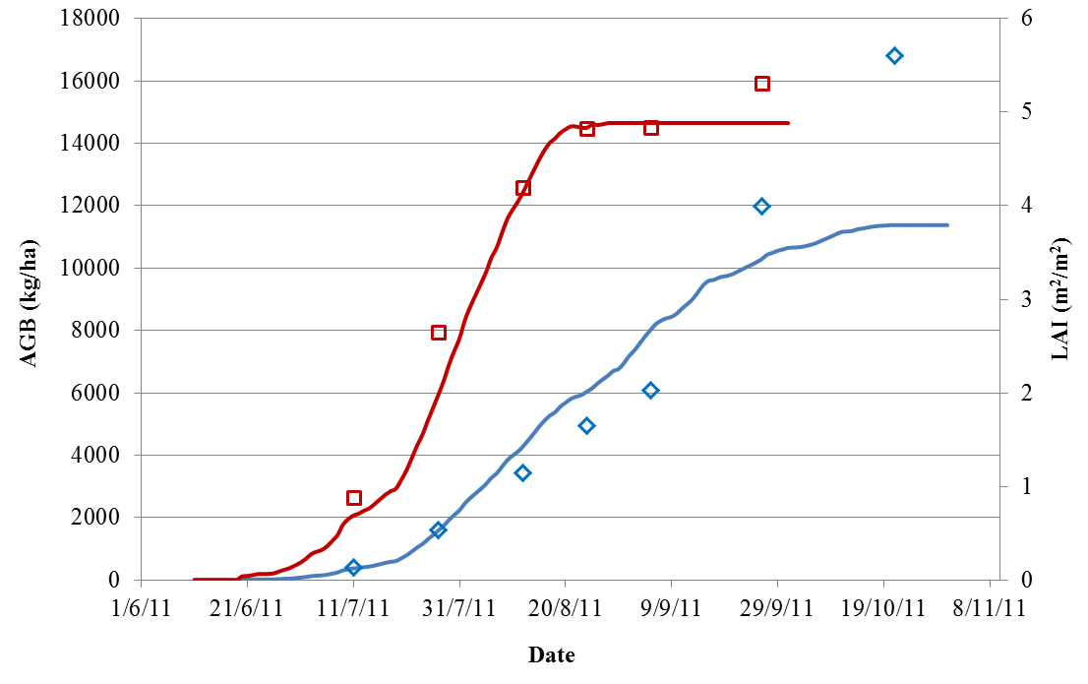
Task 3.2 deliverables
Partners: UMIL, JAAS, JRC
Calibration results (where main problems occurred) – WARM
E-AGRI WP3 – Second progress meeting - Nanjing, December 10-12, 2012
SD5
Direct sowing
SD1
Transplanting

Slide 14
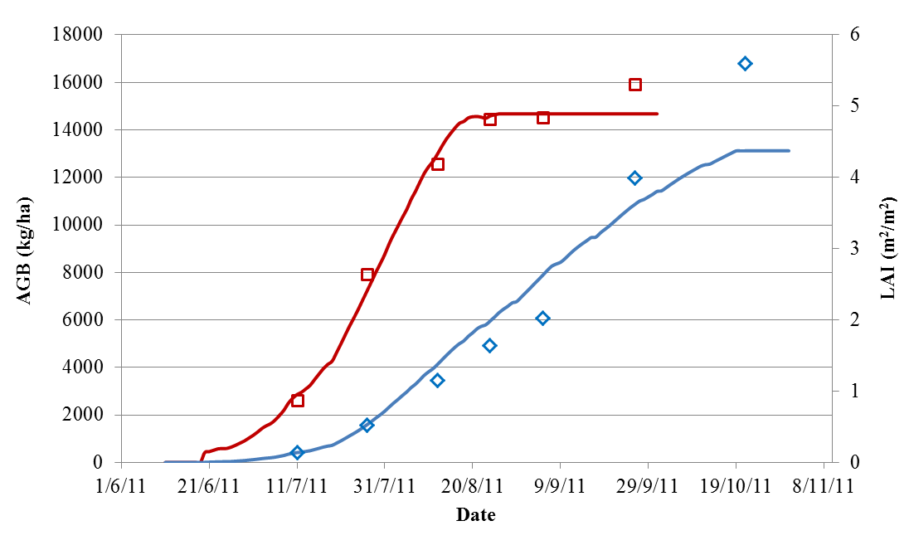
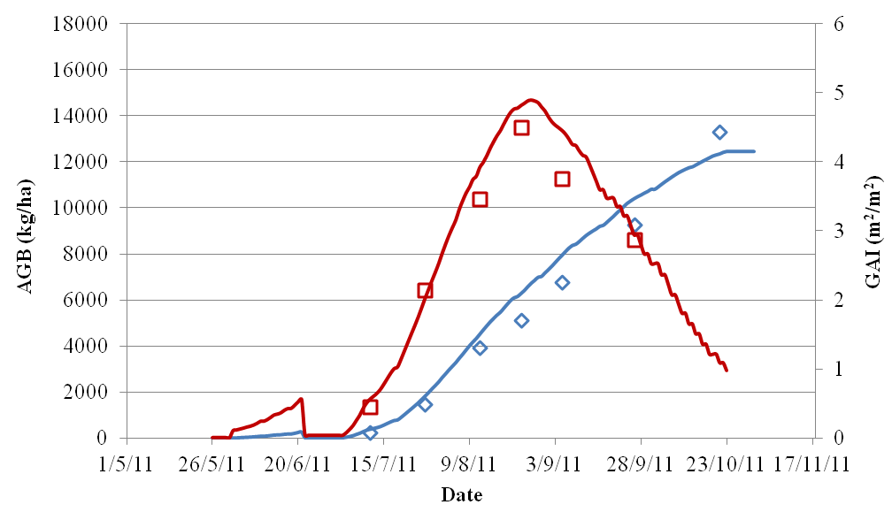
Task 3.2 deliverables
Partners: UMIL, JAAS, JRC
Calibration results (where main problems occurred) – WOFOST
E-AGRI WP3 – Second progress meeting - Nanjing, December 10-12, 2012
SD5
Direct sowing
SD1
Transplanting

Slide 15
Task 3.2 deliverables
Partners: UMIL, JAAS, JRC
Evaluation of BioMA models for field-scale simulation of rice
Accuracy (Relative root mean square error, RRMSE; Modelling efficiency, EF)
Robustness (Robustness indicator)
Complexity (Akaike Information Criterion)
E-AGRI WP3 – Second progress meeting - Nanjing, December 10-12, 2012

Slide 16
Task 3.2 deliverables
Partners: UMIL, JAAS, JRC
Evaluation of BioMA models for field-scale simulation of rice
Accuracy
Direct sowing
Calibration
E-AGRI WP3 – Second progress meeting - Nanjing, December 10-12, 2012
Variable | Model | Site | RRMSE (%) | Mean | EF | Mean | CRM
AGB | CropSyst | SD3 | 25.28 | 31.04 | 0.90 | 0.85 | 0.00
 |  | SD5 | 35.87 |  | 0.82 |  | 0.10
 |  | SD6 | 31.97 |  | 0.83 |  | 0.12
 | WARM | SD3 | 27.60 | 32.15 | 0.88 | 0.84 | -0.04
 |  | SD5 | 36.03 |  | 0.82 |  | 0.07
 |  | SD6 | 32.83 |  | 0.82 |  | 0.01
 | WOFOST | SD3 | 20.54 | 22.58 | 0.93 | 0.92 | -0.07
 |  | SD5 | 25.88 |  | 0.91 |  | 0.03
 |  | SD6 | 21.31 |  | 0.93 |  | 0.03
LAI | CropSyst | SD3 | 14.82 | 13.18 | 0.86 | 0.84 | -0.12
 |  | SD5 | 6.37 |  | 0.98 |  | -0.05
 |  | SD6 | 18.36 |  | 0.68 |  | -0.03
 | WARM | SD3 | 9.19 | 13.69 | 0.94 | 0.80 | -0.02
 |  | SD5 | 9.07 |  | 0.95 |  | 0.06
 |  | SD6 | 22.82 |  | 0.51 |  | 0.07
 | WOFOST | SD3 | 5.14 | 9.52 | 0.98 | 0.89 | -0.03
 |  | SD5 | 5.71 |  | 0.98 |  | 0.02
 |  | SD6 | 17.17 |  | 0.71 |  | 0.02
20.79
Without the value at maturity!
23.78
21.19

Slide 17
Task 3.2 deliverables
Partners: UMIL, JAAS, JRC
Evaluation of BioMA models for field-scale simulation of rice
Accuracy
Direct sowing
Validation
E-AGRI WP3 – Second progress meeting - Nanjing, December 10-12, 2012
Variable | Model | Site | RRMSE (%) | Mean | EF | Mean | CRM
AGB | CropSyst | SD2 | 29.61 | 34.56 | 0.86 | 0.83 | 0.00
 |  | SD4 | 39.51 |  | 0.79 |  | 0.11
 | WARM | SD2 | 30.44 | 35.04 | 0.86 | 0.82 | -0.03
 |  | SD4 | 39.64 |  | 0.79 |  | 0.07
 | WOFOST | SD2 | 25.23 | 28.21 | 0.90 | 0.89 | -0.05
 |  | SD4 | 31.19 |  | 0.87 |  | 0.05
LAI | CropSyst | SD2 | 33.81 | 21.25 | 0.24 | 0.60 | -0.31
 |  | SD4 | 8.89 |  | 0.95 |  | -0.04
 | WARM | SD2 | 20.48 | 15.29 | 0.72 | 0.83 | -0.14
 |  | SD4 | 10.10 |  | 0.94 |  | 0.05
 | WOFOST | SD2 | 18.90 | 13.99 | 0.76 | 0.86 | -0.17
 |  | SD4 | 9.08 |  | 0.95 |  | 0.05

Slide 18
Task 3.2 deliverables
Partners: UMIL, JAAS, JRC
Evaluation of BioMA models for field-scale simulation of rice
Accuracy
Transplanting
Calibration
E-AGRI WP3 – Second progress meeting - Nanjing, December 10-12, 2012
Variable | Model | Site | RRMSE (%) | Mean | EF | Mean | CRM
AGB | CropSyst | SD1 | 16.87 | 24.46 | 0.95 | 0.87 | -0.01
 |  | SD7 | 32.04 |  | 0.79 |  | 0.27
 | WARM | SD1 | 26.05 | 26.26 | 0.87 | 0.86 | -0.15
 |  | SD7 | 26.47 |  | 0.86 |  | 0.17
 | WOFOST | SD1 | 15.29 | 16.47 | 0.96 | 0.95 | -0.09
 |  | SD7 | 17.64 |  | 0.94 |  | 0.13
LAI | CropSyst | SD1 | 22.39 | 21.48 | 0.76 | 0.81 | -0.15
 |  | SD7 | 20.57 |  | 0.87 |  | 0.12
 | WARM | SD1 | 20.12 | 25.98 | 0.80 | 0.75 | -0.14
 |  | SD7 | 31.84 |  | 0.69 |  | 0.08
 | WOFOST | SD1 | 13.09 | 21.23 | 0.92 | 0.83 | -0.09
 |  | SD7 | 29.38 |  | 0.74 |  | 0.23

Slide 19
Task 3.2 deliverables
Partners: UMIL, JAAS, JRC
Evaluation of BioMA models for field-scale simulation of rice
Accuracy
Transplanting
Validation
Poor performances were obtained during phenology validation: all the three models anticipated the maturity date for about 15 days.
There’s probably something to improve in the transplanting model (the same used by Oryza2000)
E-AGRI WP3 – Second progress meeting - Nanjing, December 10-12, 2012
Variable | Model | Site | RRMSE (%) | Mean | EF | Mean | CRM
AGB | CropSyst |  | 28.41 | 37.41 | 0.83 | 0.69 | 0.23
 |  |  | 46.41 |  | 0.55 |  | 0.36
 | WARM |  | 17.42 | 31.19 | 0.94 | 0.76 | 0.03
 |  |  | 44.96 |  | 0.58 |  | 0.30
 | WOFOST |  | 12.16 | 22.96 | 0.97 | 0.87 | 0.05
 |  |  | 33.76 |  | 0.76 |  | 0.23
LAI | CropSyst |  | 35.57 | 37.93 | 0.42 | 0.19 | 0.26
 |  |  | 40.28 |  | -0.04 |  | 0.34
 | WARM |  | 31.01 | 37.27 | 0.56 | 0.17 | 0.08
 |  |  | 45.43 |  | -0.21 |  | 0.37
 | WOFOST |  | 54.50 | 45.82 | -0.36 | -0.12 | 0.43
 |  |  | 37.14 |  | 0.12 |  | 0.32

Slide 20
Task 3.2 deliverables
Partners: UMIL, JAAS, JRC
Evaluation of BioMA models for field-scale simulation of rice
Robustness (Robustness indicator, I_{R})
E-AGRI WP3 – Second progress meeting - Nanjing, December 10-12, 2012
SAM ranges from -1 (arid) to +1 (wet)
I_{R} ranges from 0 (optimum) to +∞
The idea is just to calculate the ratio variability of error to variability of explored conditions
Confalonieri, R., Bregaglio, S., Acutis, M., 2010. A proposal of an indicator for quantifying model robustness based on the relationship between variability of errors an of explored conditions. Ecological Modelling, 221, 960-964.
Variable | Model | I_{R}
AGB | CropSyst | 1.94
 | WARM | 1.66
 | WOFOST | 1.12
LAI | CropSyst | 14.11
 | WARM | 9.03
 | WOFOST | 6.06

Slide 21
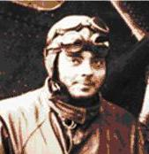
Task 3.2 deliverables
Partners: UMIL, JAAS, JRC
Evaluation of BioMA models for field-scale simulation of rice
Complexity (Akaike’s Information Criterion, AIC)
E-AGRI WP3 – Second progress meeting - Nanjing, December 10-12, 2012
n: number of couples measured/simulated
T: number of inputs
S_{i}: i-th simulated value
Mi: i-th measured value
“Perfection is reached not when there is nothing left to add, but when there is nothing left to take away” (Antoine de Saint Exupéry (The Little Prince), 1900-1944)
Gives a good score to models that guarantee good performances while requiring few inputs.
It is considered as a nice operational formulation of the Occam’s razor.
Akaike, H., 1974. A new look at the statistical model identification. IEEE Transactions on Automatic Control, 19, 716-723.
Variable | Model | I_{R}
AGB | CropSyst | 65.2
 | WARM | 57.36
 | WOFOST | 93.54

Slide 22
Task 3.2 deliverables
Partners: UMIL, JAAS, JRC
Evaluation of BioMA models for large area simulation of rice
E-AGRI WP3 – Second progress meeting - Nanjing, December 10-12, 2012

Slide 23
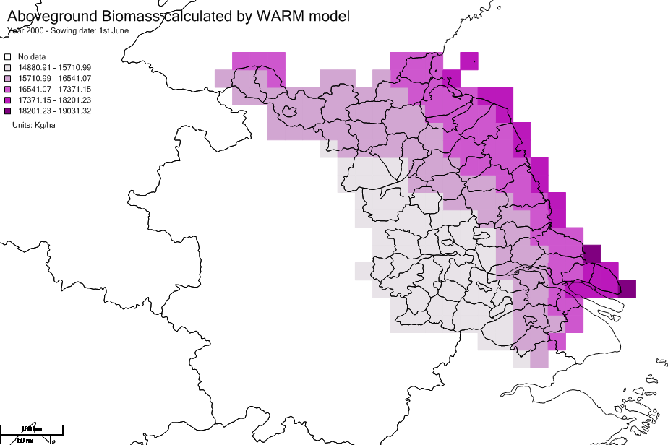
Task 3.2 deliverables
Partners: UMIL, JAAS, JRC
E-AGRI WP3 – Second progress meeting - Nanjing, December 10-12, 2012

Slide 24
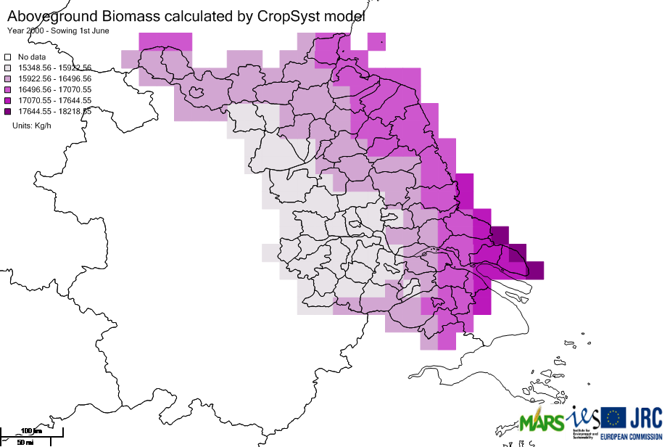
Task 3.2 deliverables
Partners: UMIL, JAAS, JRC
E-AGRI WP3 – Second progress meeting - Nanjing, December 10-12, 2012

Slide 25
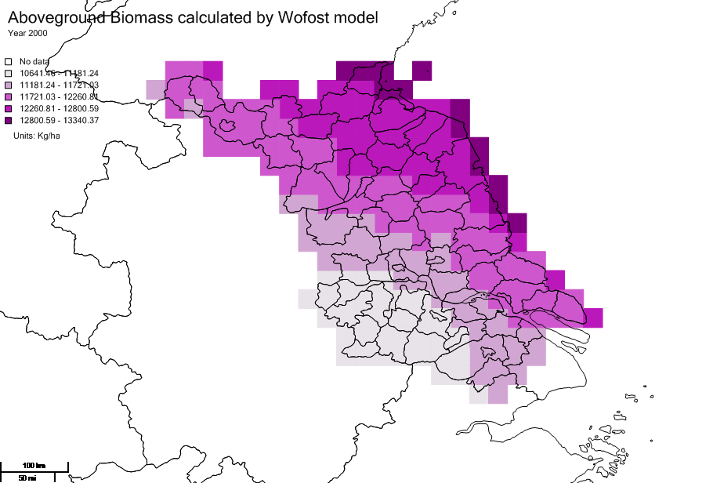
Task 3.2 deliverables
Partners: UMIL, JAAS, JRC
E-AGRI WP3 – Second progress meeting - Nanjing, December 10-12, 2012

Slide 26
Task 3.4 deliverables
Partners: JRC, UMIL
Calibration of parameters for each group of cultivars and for each crop model (WOFOST and CropSyst) for wheat in Morocco
We are waiting for the data…
E-AGRI WP3 – Second progress meeting - Nanjing, December 10-12, 2012

Slide 27
Task 3.3&5 description
Partners: UMIL, JRC, JAAS, INRA
E-AGRI WP3 – Second progress meeting - Nanjing, December 10-12, 2012
MS3
Rice, China
Wheat, Morocco
Task 3.1
BioMA adaptation
Task 3.2
Task 3.4
BioMA piloting
Task 3.3
Task 3.5

Slide 28
Considerations
After the first year
At the end of my presentation during the first progress meeting:
[…] We just had some “communication problems” [INRA]… we are surely able to improve on this point
Now, after one year:
those “communication problems” seems to be successfully solved.
The other activities are proceeding as planned [JAAS], with interesting results (especially for the multi-model approach).
Marcello is leaving JRC…
WP3 is producing tangible results: a first version of the platform will be delivered to JAAS (and to all of you) tomorrow and scientific papers on ISI journals were published
E-AGRI WP3 – Second progress meeting - Nanjing, December 10-12, 2012

Slide 29
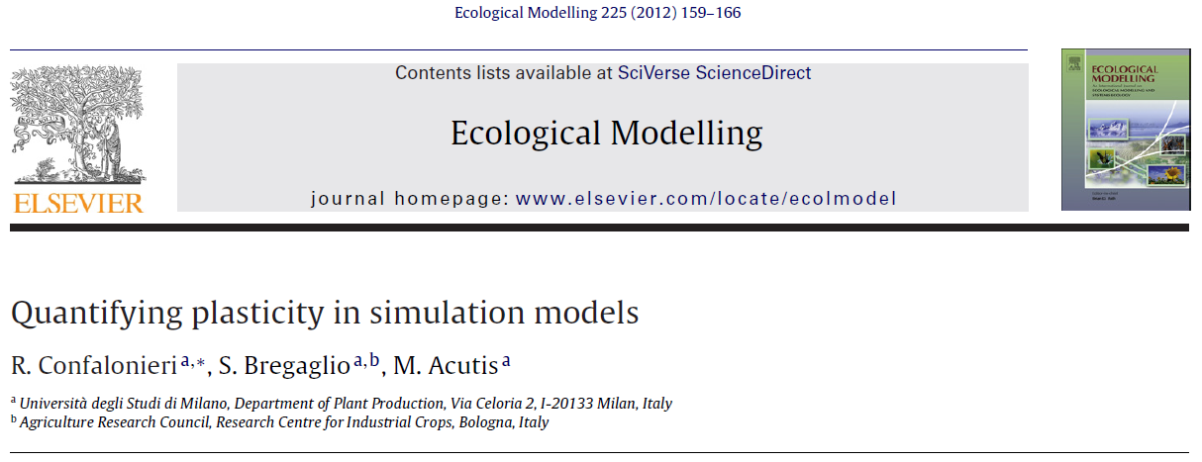
ISI Papers (1)
E-AGRI acknowledged
E-AGRI WP3 – Second progress meeting - Nanjing, December 10-12, 2012

Slide 30
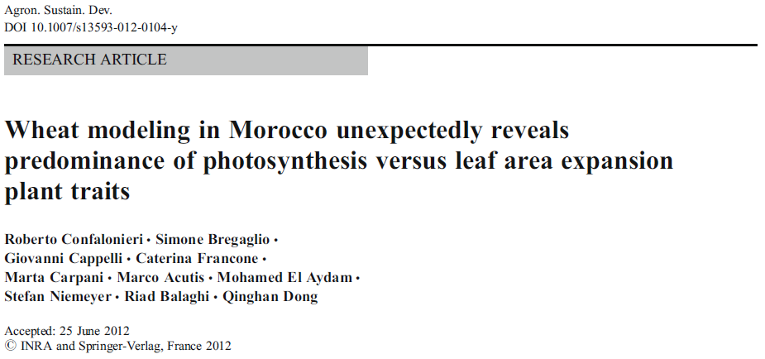
ISI Papers (2)
E-AGRI acknowledged
E-AGRI WP3 – Second progress meeting - Nanjing, December 10-12, 2012

Slide 31
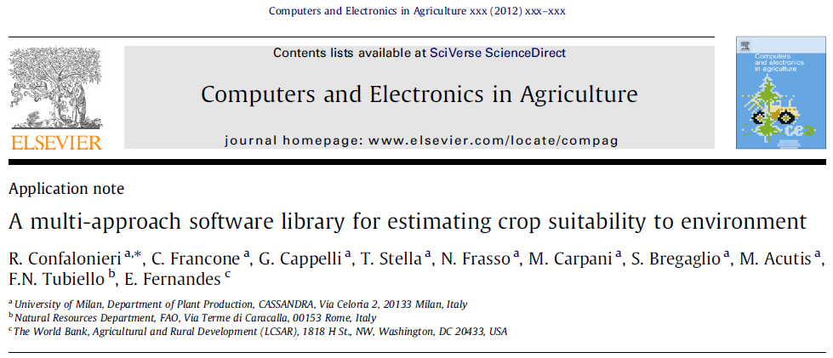
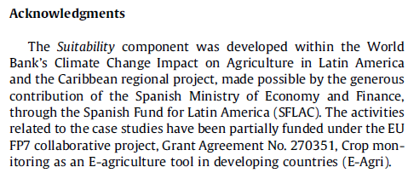
ISI Papers (3)
E-AGRI acknowledged
E-AGRI WP3 – Second progress meeting - Nanjing, December 10-12, 2012

Slide 32
Third year activities
- Before the next progress meeting -
E-AGRI WP3 – Second progress meeting - Nanjing, December 10-12, 2012
MS1

Slide 33
Third year activities
- Before the next progress meeting -
For the activity 4 “Evaluation of BioMA models for large area simulation of rice/wheat”, diseases and abiotic damages will be also simulated
First results presented during the next review meeting (March 2013)
E-AGRI WP3 – Second progress meeting - Nanjing, December 10-12, 2012

Slide 34
Third year activities
E-AGRI WP3 – Second progress meeting - Nanjing, December 10-12, 2012

Slide 35
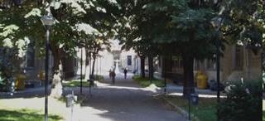
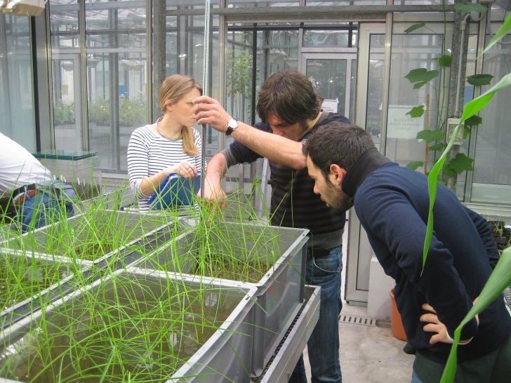
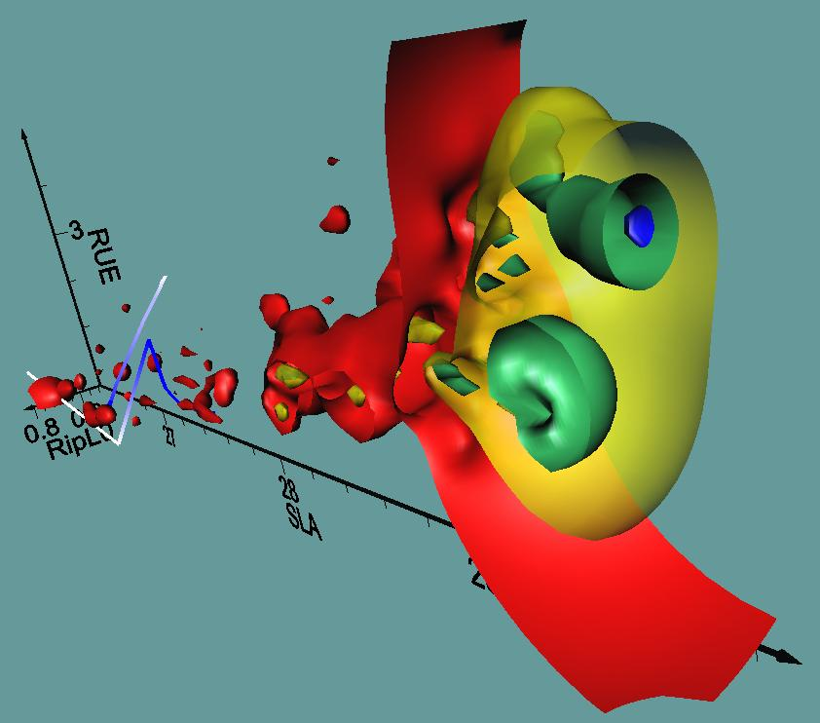
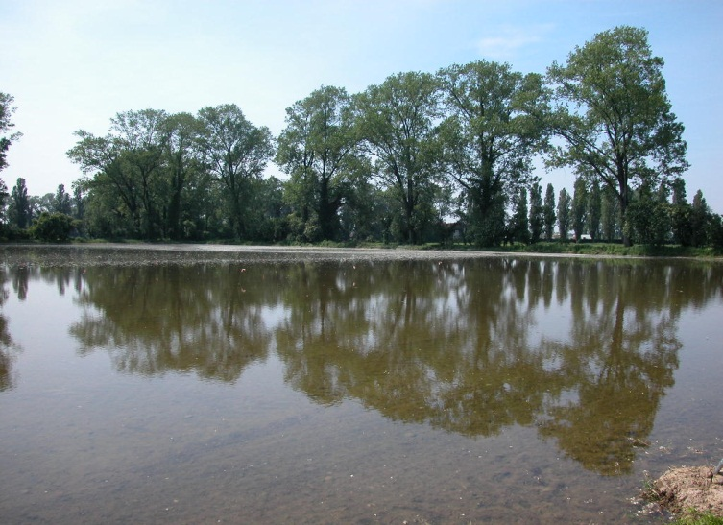
Many thanks for your kind attention

